Slide 1
Data Management System for a University

Slide 2
Creating initial business rules
I tried putting useful and applicable business rules to help in building the database based on them .

Slide 3
Business rules
- Each student can enroll in multiple courses
- Each course can be enrolled by multiple students
- Each department can provide multiple courses

Slide 4
Business rules
- Each student can get multiple grades in multiple courses
- Each course can have multiple grades (by students )
- A course can not be provided without department
- A student can not retake any course

Slide 5
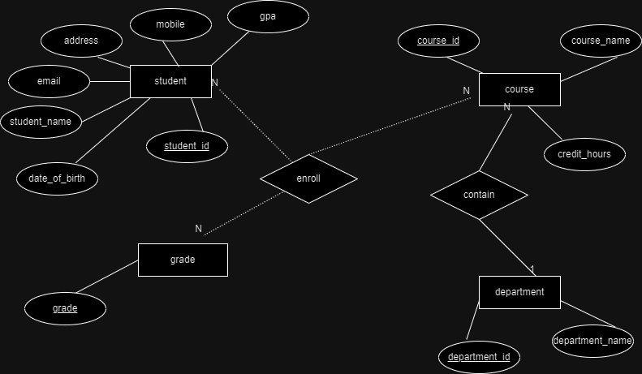
Designing the Entity-Relationship Diagram

Slide 6
Mapping the tables and their relations
1- Student : ( student_id (pk), student_name , email , address , phone_mobile , data_of_birth , gpa )
2- Course : ( course_id(pk) , course_name , department_id (fk) , credit_hours )
3- Department : (department_id (pk) , course_name )
4- Grade : (grade (pk))
5-Enrollment : (( student_id(fk) , course_id (fk) )(pk), grade)

Slide 7
Implementing the database
1 – specifying all required constraints and foreign keys
2- creating a sql script to implement the schema
3- populating the schema with a sample of data (20 students , 10 courses , 5 departments and all possible grades ) to validate the database constraints

Slide 8
PL SQL Scripts
1 – trigger (update_gpa ) :
This trigger works once a new record is added in enrollments table ..it collect all the enrolled courses related to that student and calculates the total hours of courses and the total points of them and finally if update the gpa value in students table
- note : gpa value in students table starts with a null and then it got updated with every new enrollment

Slide 9
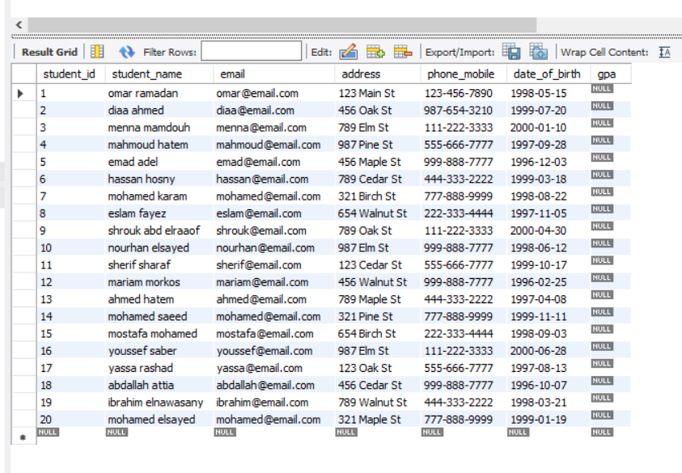
Students table before adding any enrollments

Slide 10
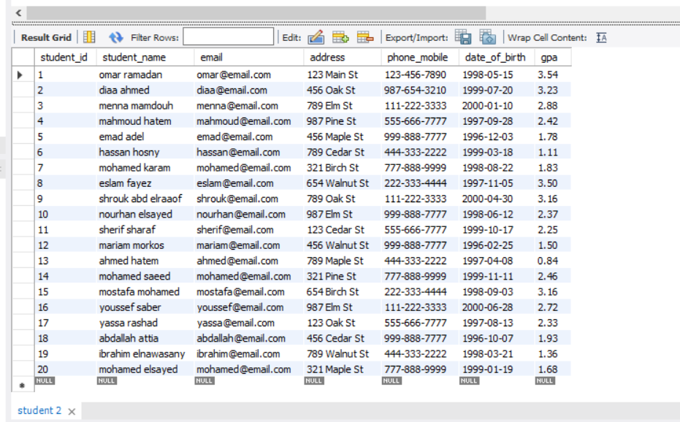
Students table after adding any enrollments

Slide 11
Procedures
I created a procedure (update_student) which takes all student’s information (student_id , student_name , email , address , phone_mobile , date_of_birth )as a parameters and update them based on student_id

Slide 12
Procedures
I created a procedure (update_course) which takes all course’s information (course_id , course_name , department_id, credit_hours)as a parameters and update them based on course_id

Slide 13
Bash Script
I created a script called (database_backup) and ran it using git bash to save a copy from the project’s database to be a reference in case any table of the database got removed accidently

Slide 14
Bash Script
I created a script and ran it using git bash to monitor disk space and send alert to notify me if it exceeds a specific percentage

Slide 15
Java application
I tried to create simple GUI to execute CRUD operations

Slide 16
Students scene
You can insert , update or delete any student from this scene .
Also you can display the data of all students using (show students) button .
I used an observable list of type (student) to store the students data and then setting them to a table view that I created using scene builder

Slide 17
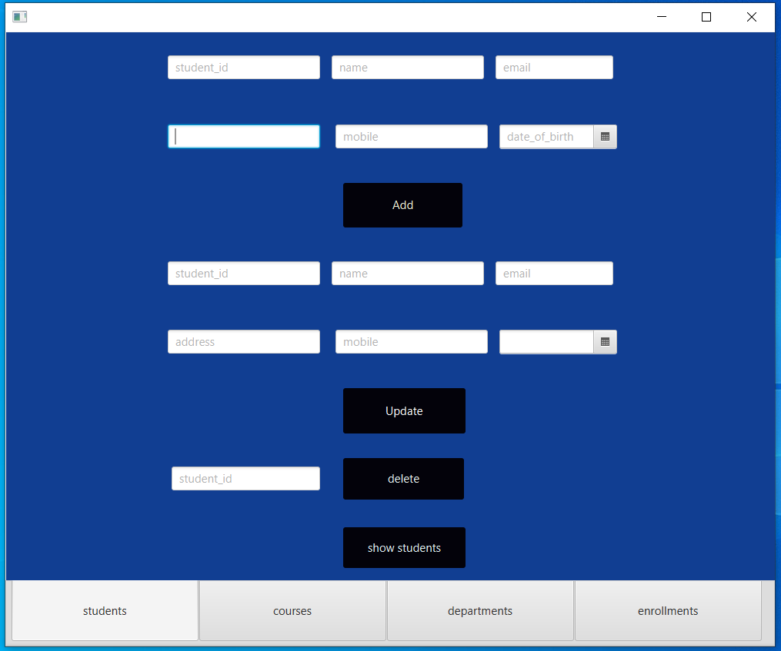

Slide 18
Students validations
I applied some validations to prevent any invalid entry from the user .
These validations handles deleting or updating a student who deos not exist
Also it handles deleting student who enrolled in one or more courses
Also it handles adding a new student with existing student id

Slide 19
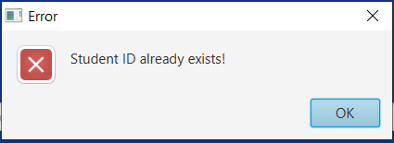
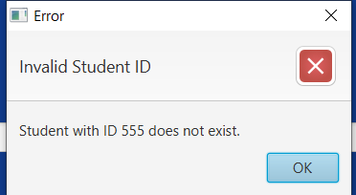
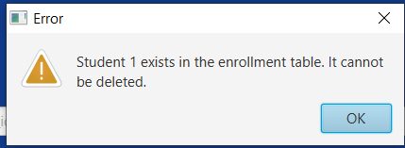
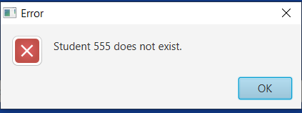
Students validations

Slide 20
Students scene
Also you can display the data of all students using (show students) button .
I used an observable list of type (student) to store the students data and then setting them to a table view that I created using scene builder

Slide 21
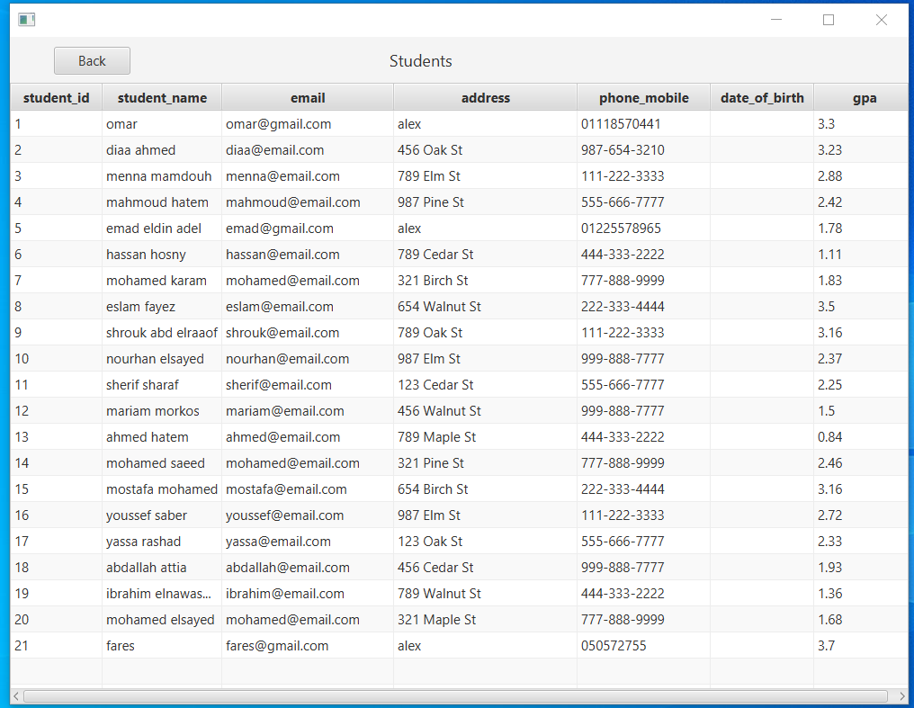

Slide 22
Courses scene
You can insert , update or delete any course from this scene .

Slide 23
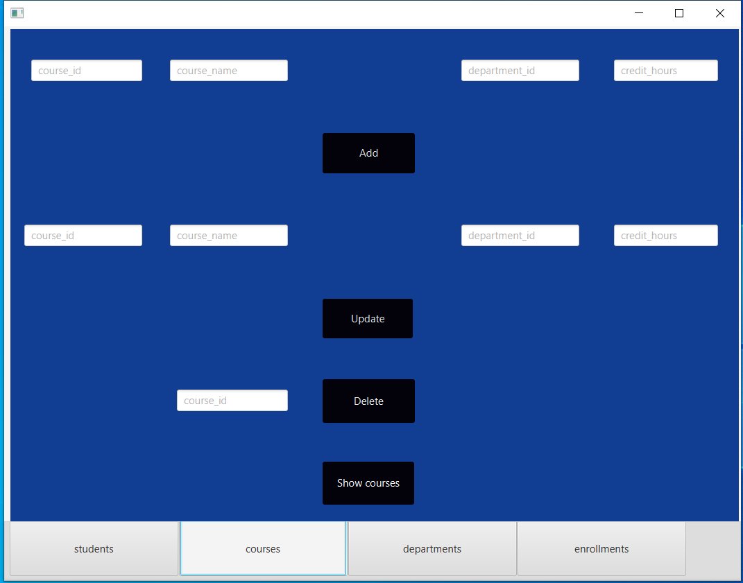

Slide 24
Courses validations
I applied some validations to prevent any invalid entry from the user .
These validations handles deleting or updating a course which does not exist
Also it handles deleting course which is enrolled by one or more courses
Also it handles adding a new course with existing course id
Also it handles adding a new course with department id that does not exist

Slide 25
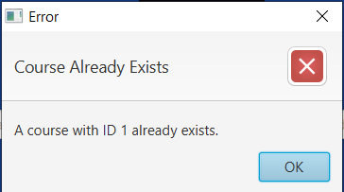
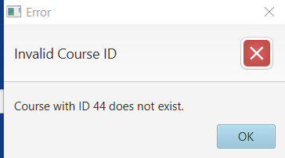
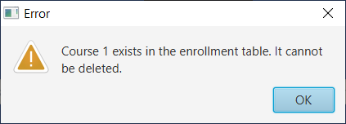
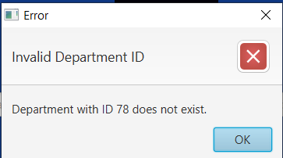
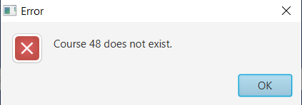
Courses validations

Slide 26
Courses scene
Also you can display the data of all courses using (show courses) button .
I used an observable list of type (course) to store the courses data and then setting them to a table view that I created using scene builder

Slide 27
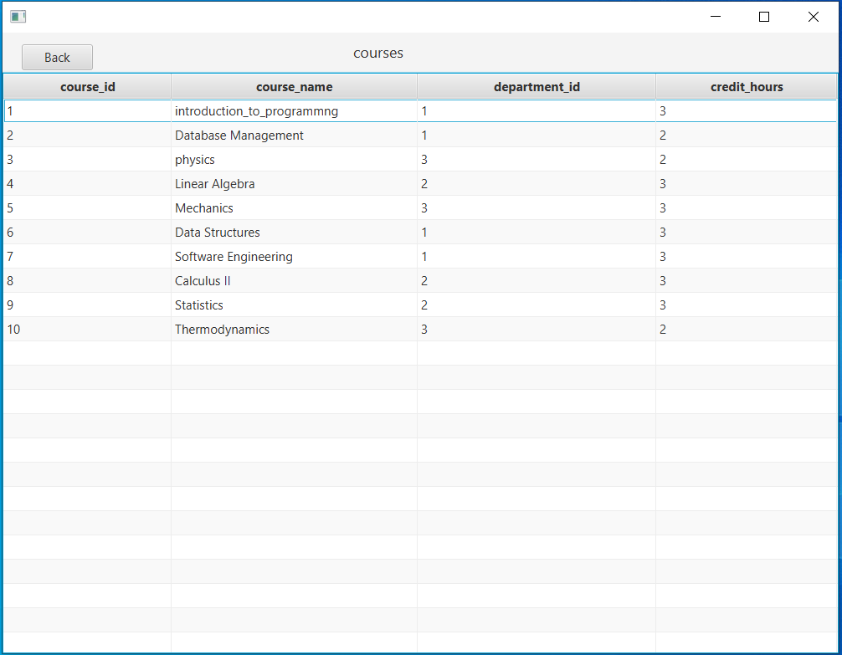

Slide 28
Departments scene
You can insert , update or delete any department from this scene .

Slide 29
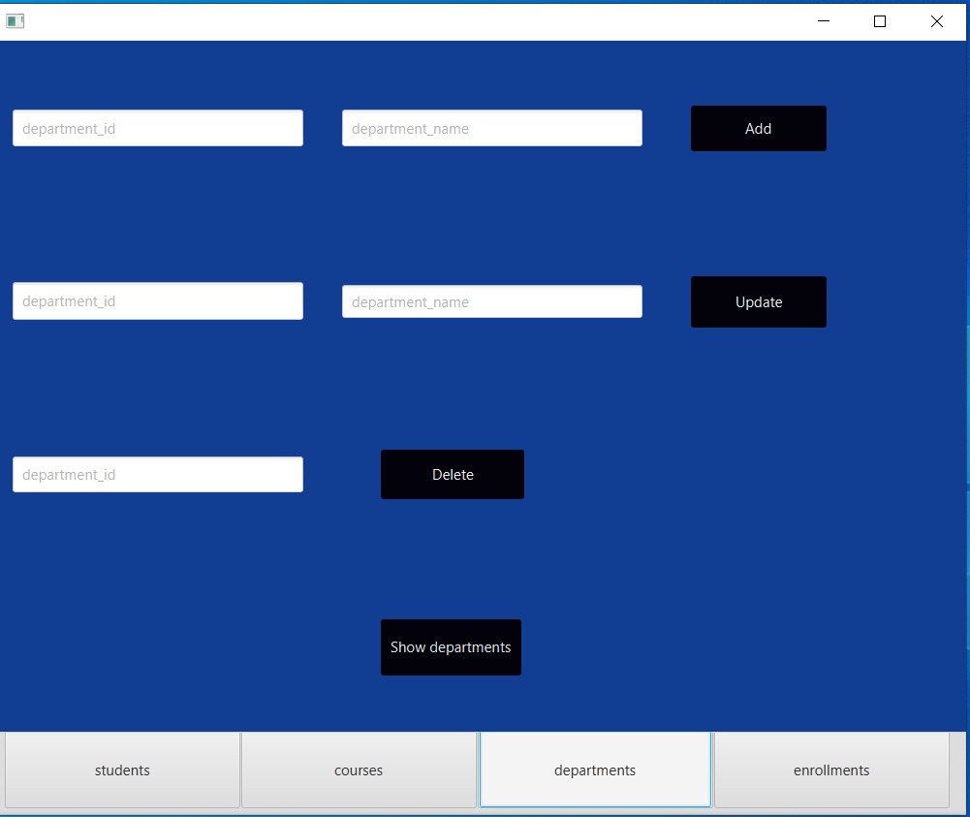

Slide 30
Departments validations
I applied some validations to prevent any invalid entry from the user .
These validations handle deleting or updating a department which does not exist
Also it handle deleting department which provides one or more courses
Also it handle adding a new department with existing department id

Slide 31
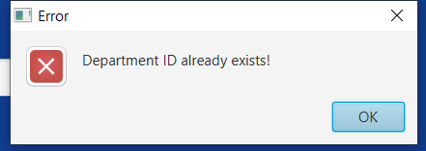
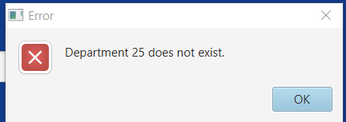
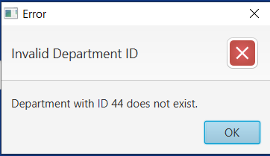
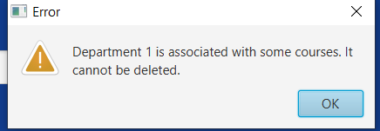
Departments validations

Slide 32
Departments scene
Also you can display the data of all departments using (show departments) button .
I used an observable list of type (department) to store the departments data and then setting them to a table view that I created using scene builder

Slide 33
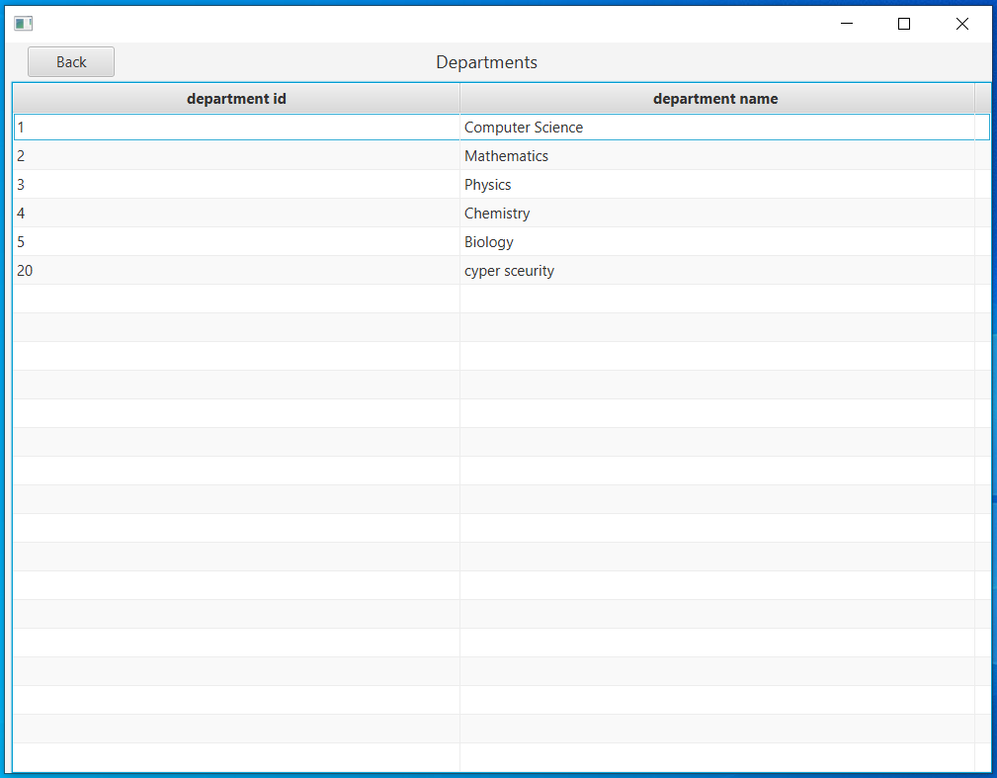

Slide 34
Enrollments scene
You can only insert any enrollment from this scene .
You can not update or delete any existing record
Once you entered a record it becomes final so you need to be careful during insertion the data

Slide 35
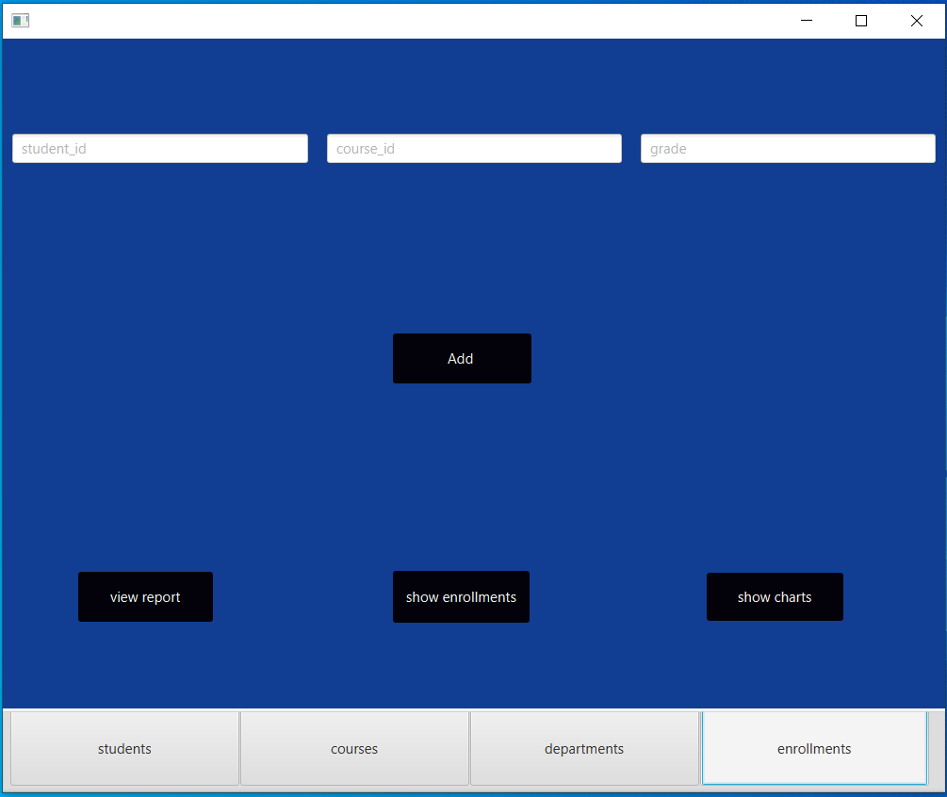

Slide 36
Enrollments validations
I applied some validations to prevent any invalid entry from the user
These validations handle adding a new enrollment with invalid student id or course id or grade Also it handle adding a new enrollment with existing student id and course id (prevent duplication )

Slide 37
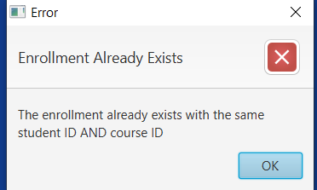
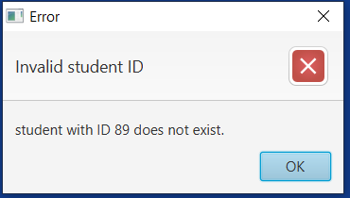
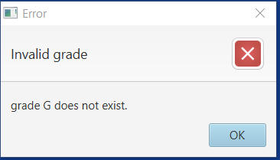
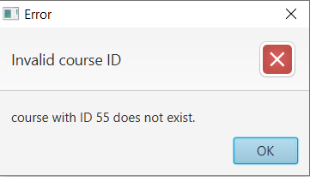
Enrollments validations

Slide 38
Enrollments scene
you can display the data of all enrollments using (show enrollments) button .
I used an observable list of type (enrollments) to store the enrollments data and then setting them to a table view that I created using scene builder

Slide 39
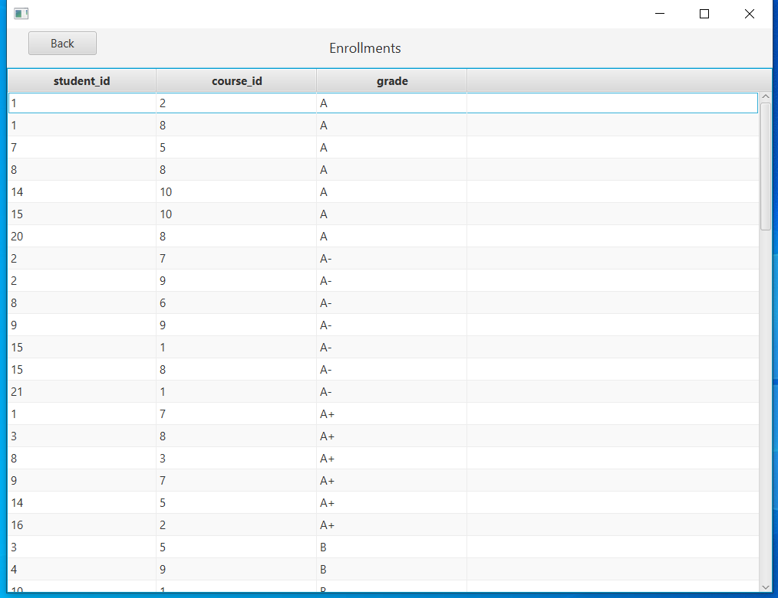

Slide 40
Enrollments scene
you can press on (show report ) button and it will display a report about courses and number of students who enrolled in each course and the average gpa of them in each course

Slide 41
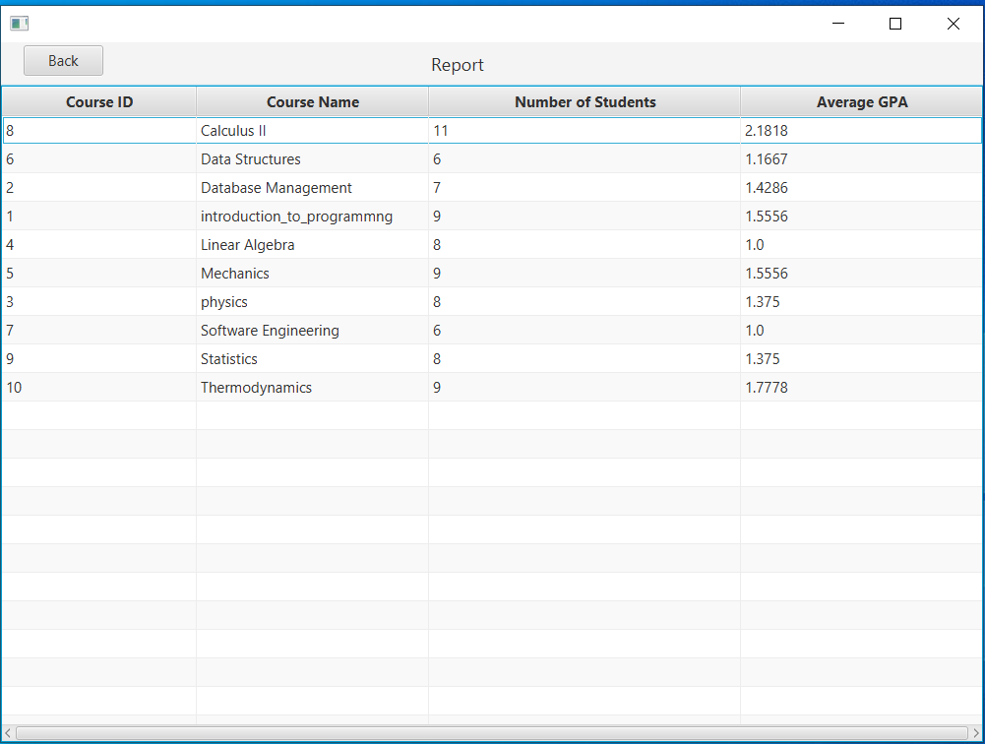

Slide 42
Enrollments scene
you can press on (show charts ) button and it will display two simple charts
The first chart shows how many students got each grade
The second chart shows how how many students enrolled in each course

Slide 43
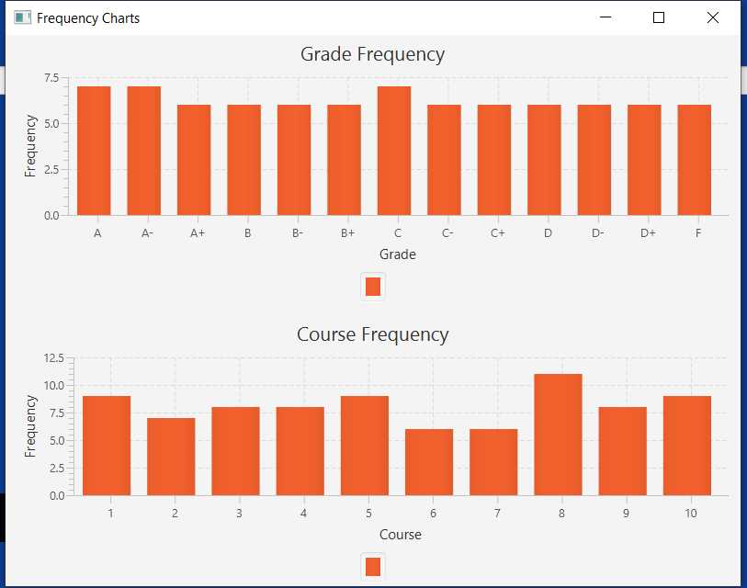

Slide 44

Thank you
Omar ramdan

